Slide 1
Exploring GAN
Machine Learning and Data Mining
Anton Zaitsev – Othmane Mahfoud

Slide 2
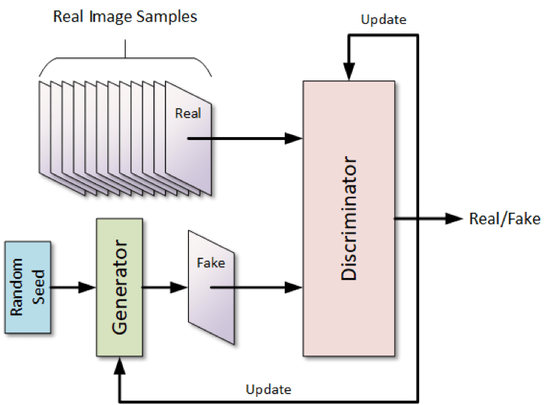
Generative Adversarial Network (GAN)
Deep learning framework with two models playing against each other.
First, is the generator which generates fake images from real images.
Second, is the discriminator that tries to identify fakes from real.
The result goes back to the generator and discriminator so that they improve.
This feedback acts as training for the generator to create better images, and for the discriminator to do a better job of adjudicating.
Notes:
Two Players in a Game: Think of a GAN as a system with two key players: the Generator and the Discriminator. It's like an artist (Generator) and an art critic (Discriminator) playing a game.
The Artist's Job: The generator, or the artist, tries to create paintings (images, music, text, etc.) that look as real as possible. Its goal is to make art so convincing that it looks like it could have come from the real world.
The Critic's Job: The discriminator, or the art critic, looks at both the artist's paintings and real-world items to decide which ones are real and which ones are fake. Its job is to catch the fakes.
Improving Skills: As the game progresses, the artist learns from the critic’s feedback and tries to improve their art. At the same time, the critic gets better at distinguishing between real and fake items. This loop continues, with both the artist and the critic improving over time.
End Goal: The ultimate goal of this game is for the artist to become so good at creating art that the critic can't tell the difference between what's real and what's fake. When the critic is fooled consistently, the GAN has done its job well, producing highly realistic outputs.

Slide 3
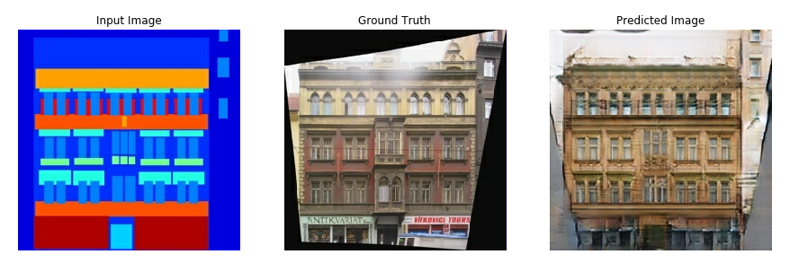
Pix2Pix
Image-to-Image translation framework
Conditional GAN
Similar training process
Architecture choices (U-net/PatchGAN)
Notes:
Image-to-Image Translation Framework: Pix2Pix is a method for translating one type of image into another using a conditional Generative Adversarial Network (cGAN). This is useful for tasks like converting architectural labels into photographs, transforming sketches into realistic images, or changing day scenes to night.
Generative Adversarial Network (GAN): The system operates using a GAN framework, which consists of two main components:
Generator (G): A neural network that generates new images from input images.
Discriminator (D): A neural network that evaluates the authenticity of images from the generator, discerning whether they are real or artificially generated.
Conditional Model: Unlike standard GANs, Pix2Pix uses conditional GANs, where both the generator and discriminator receive additional information (input images) along with the target. This conditions the generation process, guiding the generator to produce specific outcomes based on the input image.
Training Process: During training, the generator tries to produce images that the discriminator will classify as real. Simultaneously, the discriminator learns to better distinguish between real images (from the training set) and fake images (produced by the generator). The training involves adjusting the weights of both networks through backpropagation, minimizing a loss function that captures the adversarial nature of their interaction.
Architecture Choices: The generator often uses a U-Net architecture, which is effective for pixel-wise prediction due to its use of skip connections that help preserve image details through the network layers. The discriminator usually employs a PatchGAN classifier, which judges subsets of the image (patches) instead of the entire image at once, making it efficient and scalable to larger images.
In Simpler Terms:
Image Translation: Pix2Pix is a tool that transforms one type of image into another—imagine turning a black and white drawing of a cat into a lifelike color photo. It's like a magical art machine that takes in doodles and outputs realistic images.
Learning from Examples: It learns this trick by looking at many examples. You show it pairs of images (like a sketch of a cat and a real cat photo) many times. Over time, it learns the patterns and understands how to make the transformation on its own.
Two Main Parts: The system has two main components—the Creator and the Critic. The Creator tries to make new images from sketches, and the Critic reviews these images to see if they look real or not. They work together like an artist and an art teacher, improving each other.
Getting Better Over Time: As the Critic gets better at spotting fakes, the Creator has to improve its art to make more convincing images. This loop continues until the Creator gets really good at producing realistic images from sketches.
Versatile Use: Beyond just sketches and photos, Pix2Pix can be used for various tasks like turning day photos into night, adding colors to black and white photos, or even creating maps from satellite images. It's a versatile tool that adapts to what it’s taught.
In essence, Pix2Pix uses examples to master the art of transforming images, learning to improve through a continuous cycle of creation and critique.

Slide 4
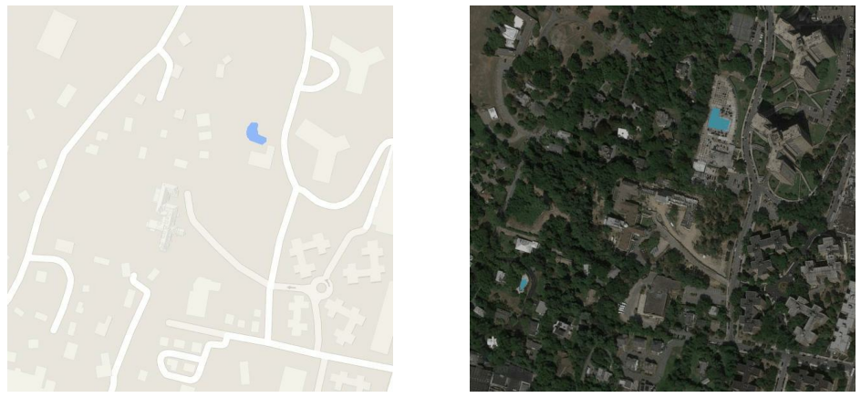
Overall Task
Notes:
Could also be the opposite for segmentation but this is our task

Slide 5
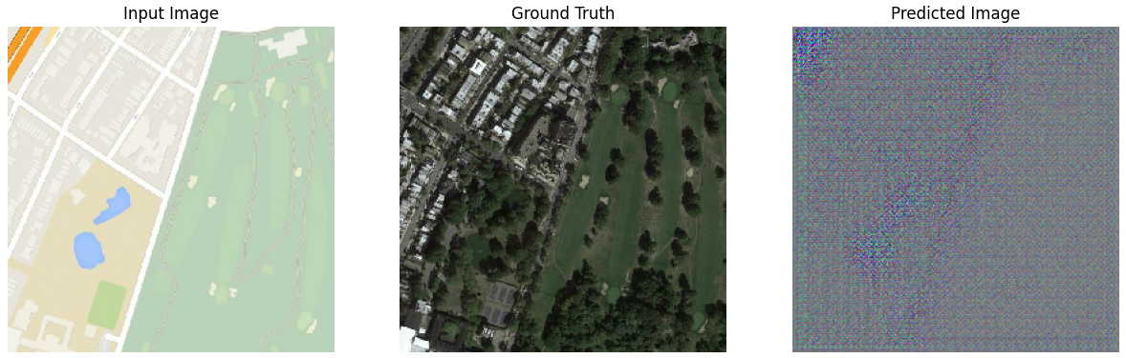
Task for the Generator
Notes:
Key Functions of the Generator:
Transformation: It accepts an input image and attempts to generate a new image that resembles the target domain as closely as possible. This transformation is conditioned on the input, meaning the output directly corresponds to the specifics of the input image.
Learning Context and Details: Through training, the generator learns the context and details necessary to perform accurate image translation. It uses a combination of convolutional layers and upsampling techniques to preserve and enhance details.
Minimizing Loss: The generator also aims to minimize the difference between its generated images and the actual images in the target domain, as judged by the discriminator. It learns to improve its outputs based on feedback from the discriminator, which assesses the realism of the generated images.

Slide 6
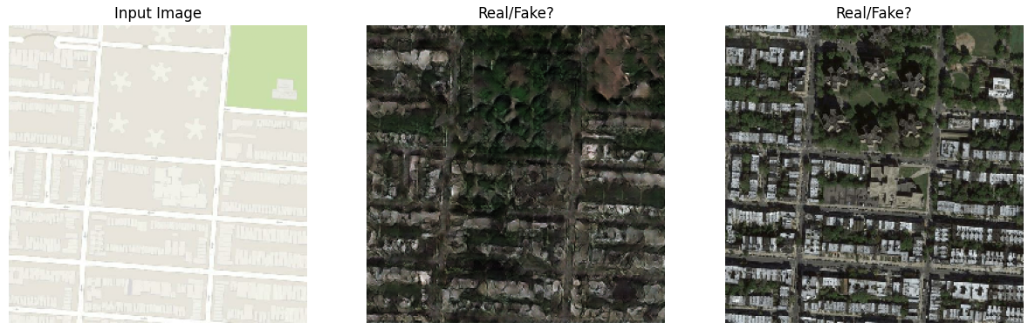
Task for the Discriminator
Hmmm… not real!
Hmmm… looks real!
Notes:
1. Authenticity Assessment:
Evaluate Realism: The primary function of the discriminator in Pix2Pix is to assess whether the images produced by the generator look real. It looks at each generated image and decides if it could pass as a real image from the target domain or if it's obviously a fake.
2. Feedback to Generator:
Provide Learning Signal: The discriminator provides critical feedback to the generator through a loss function. This feedback is part of what the generator uses to learn and improve. If the discriminator can easily tell that an image is fake, it will penalize the generator, prompting it to make better images next time.
3. Adversarial Training:
Drive Improvement: By continuously challenging the generator's outputs, the discriminator drives the adversarial training process. The goal is to make the generator's task progressively harder, forcing it to learn more sophisticated ways of mimicking real images, thus enhancing the quality and realism of its output.
4. Conditional Assessment:
Contextual Relevance: In Pix2Pix, the discriminator not only evaluates the realism of the generated images but also checks their relevance to the given input. This conditional assessment ensures that the generated output is not only realistic but also appropriate for the input context, maintaining the correct mapping from input to output domains.

Slide 7
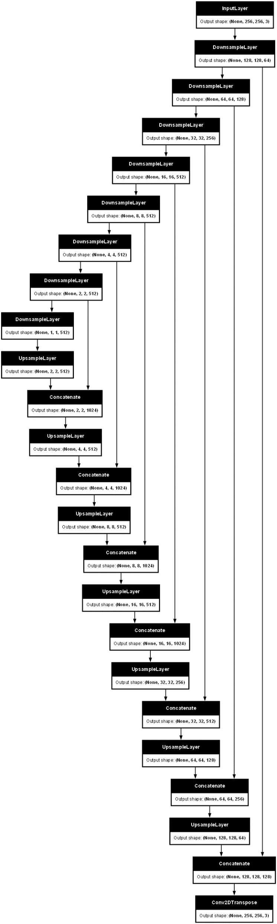
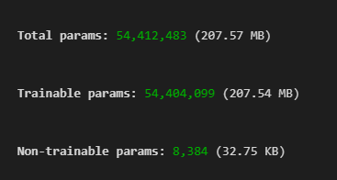
GAN Architecture (Generator)
SKIP CONNECTIONS
UPSAMPLE
DOWNSAMPLE
COMPRESSED (1x1x512) REPRESENTATION OF IMAGE
Notes:
U-Net Structure:
Think of U-Net as a factory pipeline that starts with a big block of raw material and ends with a finely detailed sculpture. Here’s how it works in steps:
Downsizing:
What Happens: Imagine you start with a large, detailed photograph. The first part of the U-Net, called the downsampling path, is like zooming out gradually. As you zoom out, you start seeing the bigger picture but lose some fine details.
Purpose: This helps the network understand the overall layout and context of the image (like recognizing that it’s a picture of a street rather than focusing on the specific bricks in the buildings).
Bottleneck:
Critical Point: This is the part where the image is the most zoomed out. It’s like having a simplified blueprint of the photo. It doesn’t have details but has all the major parts laid out.
Purpose: This stage captures the essence of the image, which will guide the reconstruction process.
Upsizing:
What Happens: Now, imagine taking that blueprint and gradually zooming back in, but as you do so, you start adding back the details you lost earlier. This is what the upsampling path does.
Purpose: This process rebuilds the image back to its original size but now informed by the blueprint created in the downsampling and bottleneck stages.
Skip Connections:
Adding Details: As you’re rebuilding the image, imagine you have a friend who took detailed notes (snapshots) of the original photo before it was zoomed out. As you rebuild each layer, your friend hands you the notes from the corresponding level of detail. These are the skip connections.
Purpose: They help ensure that the final sculpture (or image) is as detailed and accurate as the original. These connections add back the fine details to the zoomed-in image that would otherwise be lost.
In Pix2Pix:
In the Pix2Pix system, this entire process helps to take a simple input (like a line drawing of a cat) and transform it into a detailed and realistic output (like a lifelike image of a cat). The U-Net architecture ensures that the fine details are not lost and that the output closely matches what the input represents, just in a different style or form.

Slide 8
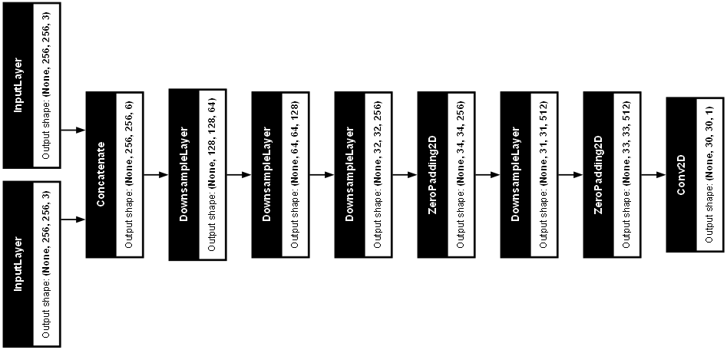
GAN Architecture (Discriminator)
PROBABILITIES (from 0 to 1) OF BEING REAL
REAL IMAGE
GENERATOR (FAKE) IMAGE
Notes:
Architecture Overview:
PatchGAN Classifier:
Design: The discriminator in Pix2Pix is commonly referred to as a PatchGAN classifier. Unlike traditional discriminators that assess the entire image at once, the PatchGAN looks at different parts or patches of the image separately. Each patch is assessed independently to determine whether it's real or fake.
Advantage: This approach focuses on the texture and local style of the image, which is often sufficient to determine its authenticity. It allows the discriminator to efficiently and effectively identify discrepancies in smaller sections of the image, which might be missed when looking at the whole image at once.
Architecture Details:
Input: The discriminator receives both the generated image and the corresponding input image (concatenated along the channel dimension) as input. This is because Pix2Pix is a conditional GAN, and the condition (input image) is provided directly to the discriminator.
Convolutional Layers: The network typically consists of several layers of convolutions. Each convolutional layer applies a set of filters meant to capture various features of the image, such as edges, textures, or specific patterns.
Normalization: Batch normalization is applied after convolutional layers (except for the first layer) to stabilize learning and normalize the features being learned.
Activation: Leaky ReLU activation is used for non-linearity without blocking the gradient flow during training. It allows a small, non-zero gradient when the unit is inactive and has been shown to help the gradient flow more effectively than standard ReLU.
Output:
Final Layer: The output of the final convolutional layer is a single-channel feature map, where each pixel represents the discriminator’s assessment of a corresponding patch in the input image. Rather than outputting a single scalar (real or fake), it outputs a matrix of scores.
Sigmoid Activation: A sigmoid activation function is applied to the output layer to squash the values between 0 and 1, representing the probability of each patch being real.
Objective Function:
Loss Calculation: The discriminator's objective is to maximize the classification accuracy for real and fake patches. For real images, it aims to output values close to 1, and for generated images, it aims to output values close to 0.
Training: During training, the discriminator’s loss is calculated based on how well it can separate real images from fakes. This loss is used to update the discriminator's weights through backpropagation.
In simpler terms:
In the Pix2Pix system, the discriminator can be thought of as the quality inspector in a factory where the factory is the generator creating products (images). Here’s a straightforward explanation of what the discriminator does and how it’s built:
Overview of the Discriminator:
Patch Checker:
Role: Instead of checking the entire image at once to see if it looks real or fake, the discriminator looks at small sections or patches of the image. It's like inspecting a patchwork quilt piece by piece, rather than all at once.
Advantage: This method lets it focus on details and textures, making it good at spotting any part that doesn't look right, even if most of the image looks pretty good.
How It Works:
Input: The discriminator gets both the input image (like a sketch) and the output image (like a colored-in version of the sketch) from the generator.
Layers: It has several layers, each acting like a filter that looks for different things in the images. The first layer might look for basic edges, and deeper layers might look for more complex patterns.
Normalization: Just like a camera adjusts to different lighting, normalization helps the discriminator adjust to different types of images and patterns.
Leaky Pipes: It uses something called a Leaky ReLU, which can be thought of as a leaky pipe that lets through a small amount of water even when it's off. This helps in making sure that all parts of the image get some attention during inspection.
Final Decision:
Patch Scores: Instead of giving one final verdict for the whole image, it gives a score to each patch, indicating how real each part looks.
Sigmoid: At the end, these scores are squeezed (using a mathematical function called sigmoid) into a range between 0 and 1, where numbers closer to 1 mean "real" and closer to 0 mean "fake."
Role in Training:
Feedback: The main job during training is to challenge the generator by being tough to fool. It provides feedback on how to improve the images, pushing the generator to make images that are harder to distinguish from real ones.
Loss Calculation: It calculates how well it's doing at catching fake images and uses this information to get better over time.

Slide 9
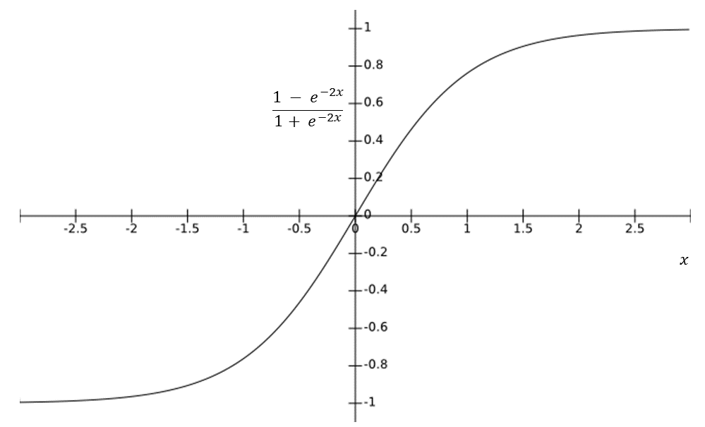
Generator
Why use Tanh activation in the Generator last layer?
We normalize the images from -1 to 1.
Generator loss
gan_loss: calculates the Binary Crossentropy loss between the discriminator's output and a tensor of ones. the generator wants the discriminator's output to be close to 1 (believing the image is real), the loss becomes smaller as the discriminator's output gets closer to 1.
L1_loss: MAE - encourages the generated image to resemble the target image in terms of pixel values; LAMBDA - weight of the MAE compared to the Binary Crossentropy loss.
total_gen_loss = weighted sum of two losses.

Slide 10
Discriminator
Why no activation function?
We use BinaryCrossentropy with from_logits=True. This function is specifically designed to work with logits (unnormalized outputs) from the discriminator.
Discriminator loss:
real_loss: the loss function wants this value to be close to 1 (real), we compare the output of the discriminator for the real image with ones. (tf.ones_like)
generated_loss: same thing, but want this to be close to 0 (fake), since compare with generator image (tf.zeros_like)
total_loss = weighted sum of two losses (notice no weights here).

Slide 11
Training
During training, we use separate gradient tapes for the generator and discrimator, which allows to calculate the gradients for each network's loss function separately within the with tf.GradientTape() block.
Gradient tape is a tool in TensorFlow for performing automatic differentiation.

Slide 12
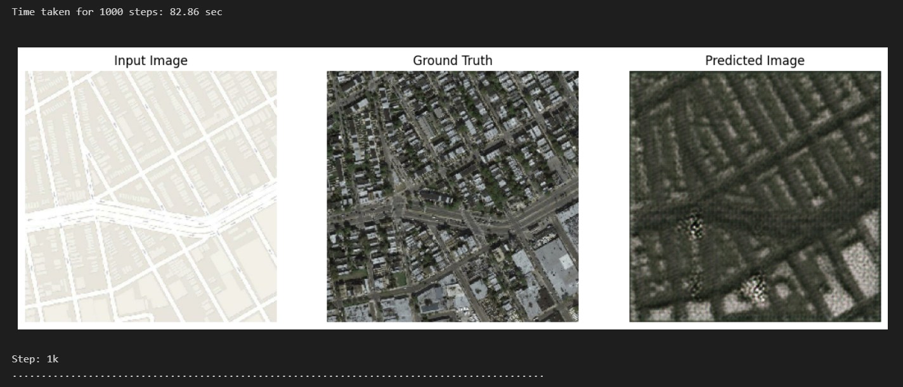
Training

Slide 13
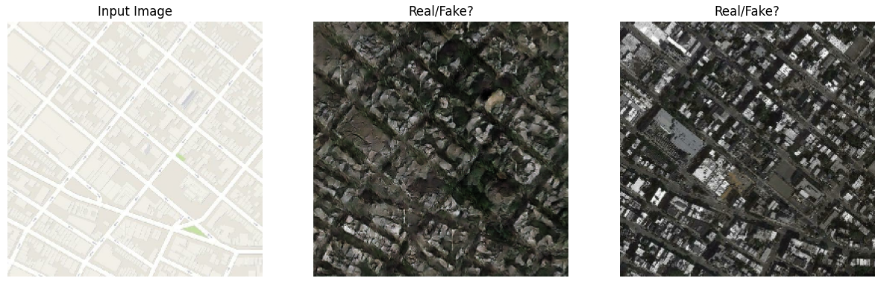
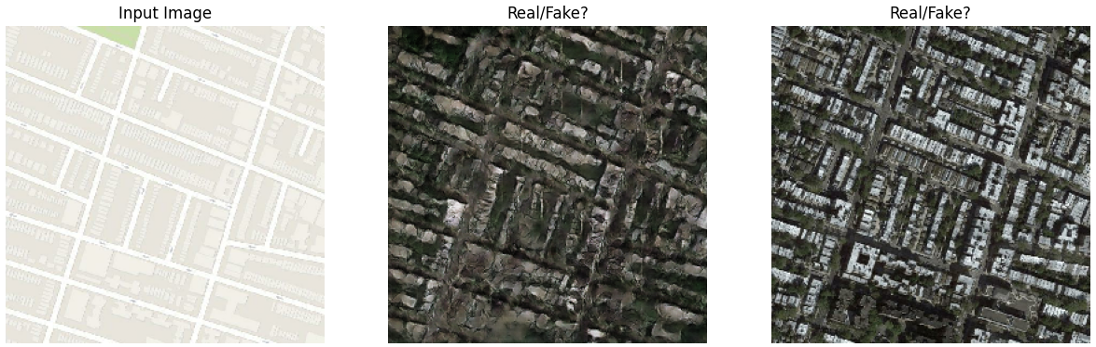
Training – After 40K Steps

Slide 14
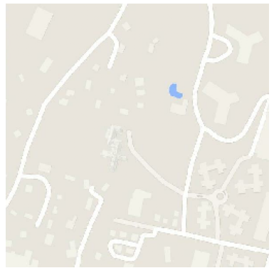
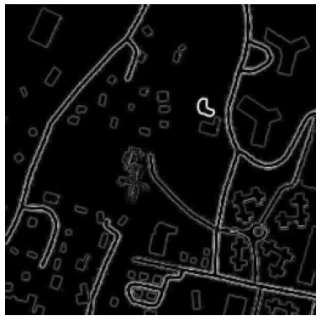
Introducing Edge Map
Terrain
Edges Map of the Terrain Image

Slide 15
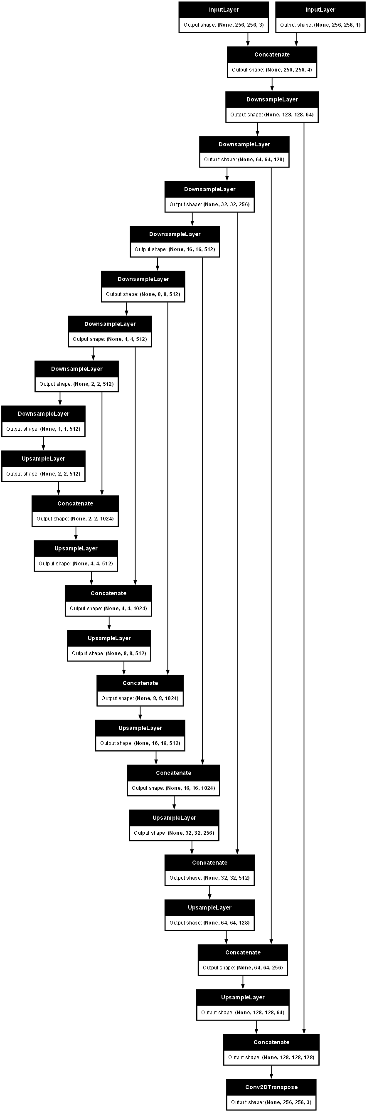
GAN Architecture (Generator) | Edge Map
EDGES
SKIP CONNECTIONS
UPSAMPLE
DOWNSAMPLE
COMPRESSED (1x1x512) REPRESENTATION OF IMAGE

Slide 16
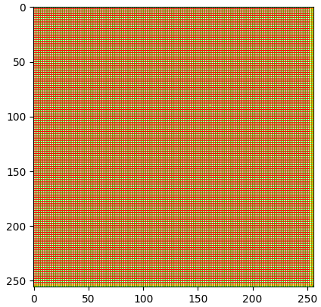
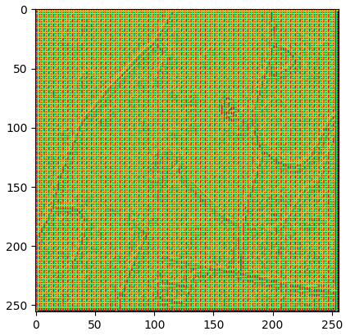
Introducing Edge Detection | Generator
Generator Prediction w/o Edges
Generator Prediction w/ Edges

Slide 17
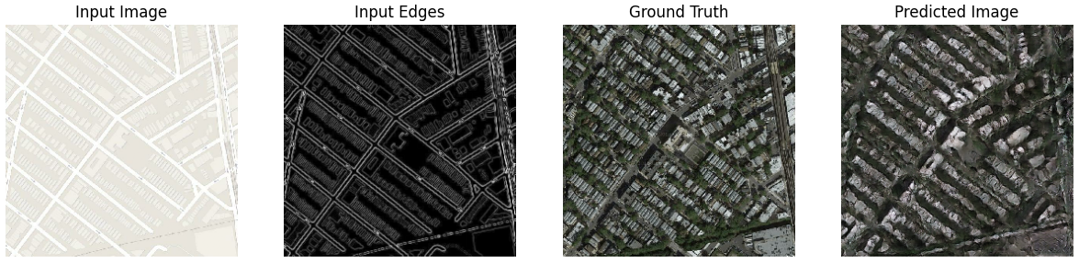
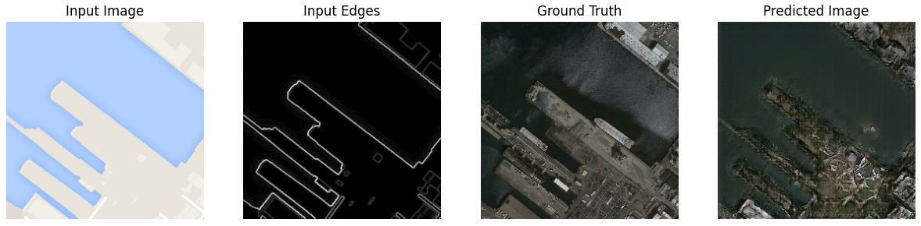
Training – After 40K Steps | Edge Map

Slide 18
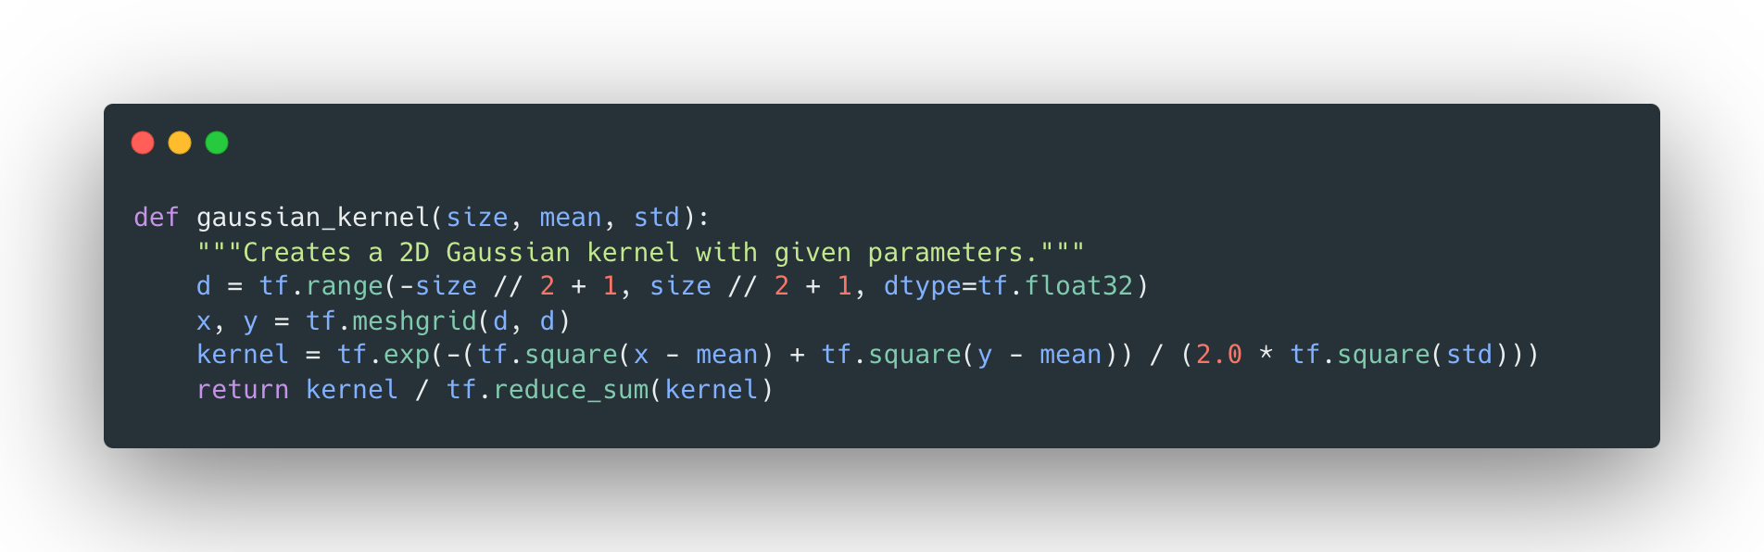
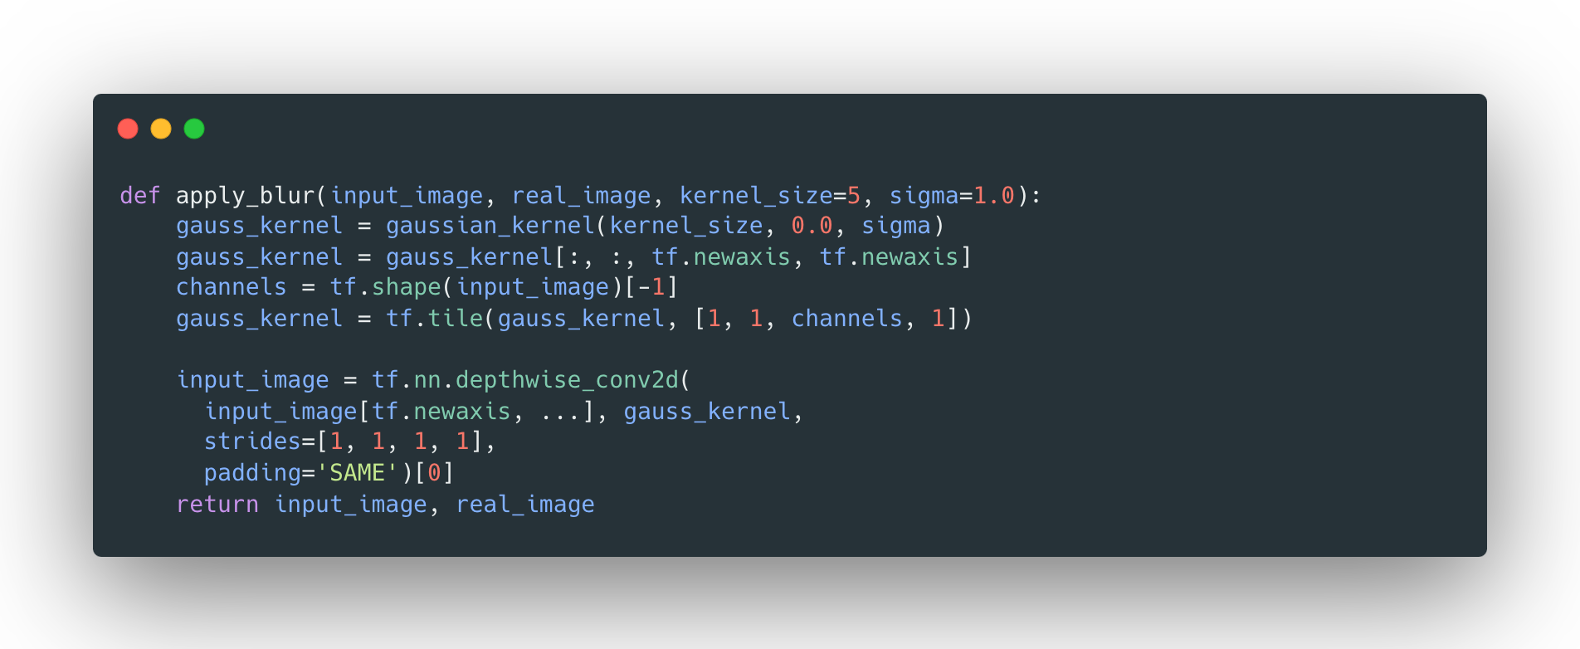
Introducing Blur – Input Pre-processing
Notes:
We then introduced blurring as a data augmentation technique with the assumption that if the model trains on a harder input it will make it more efficient in detecting details such as building edges etc.

Slide 19
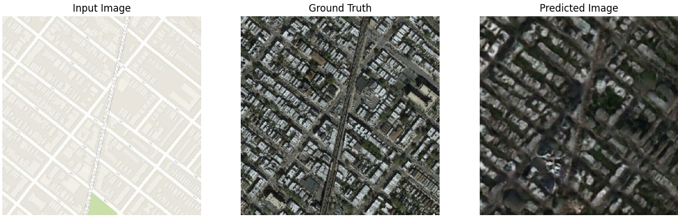
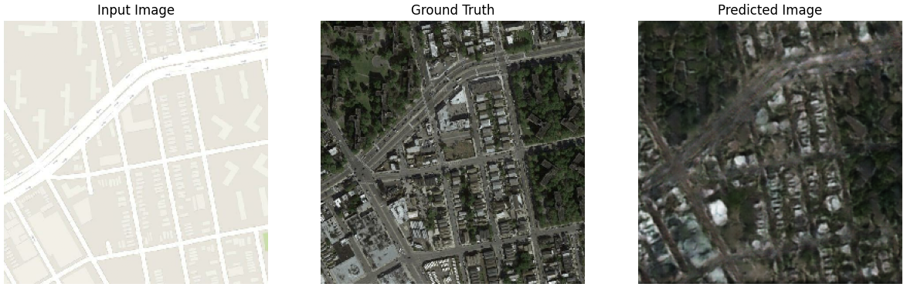
Training – After 40K Steps | Blur
Notes:
Wasn’t effective

Slide 20
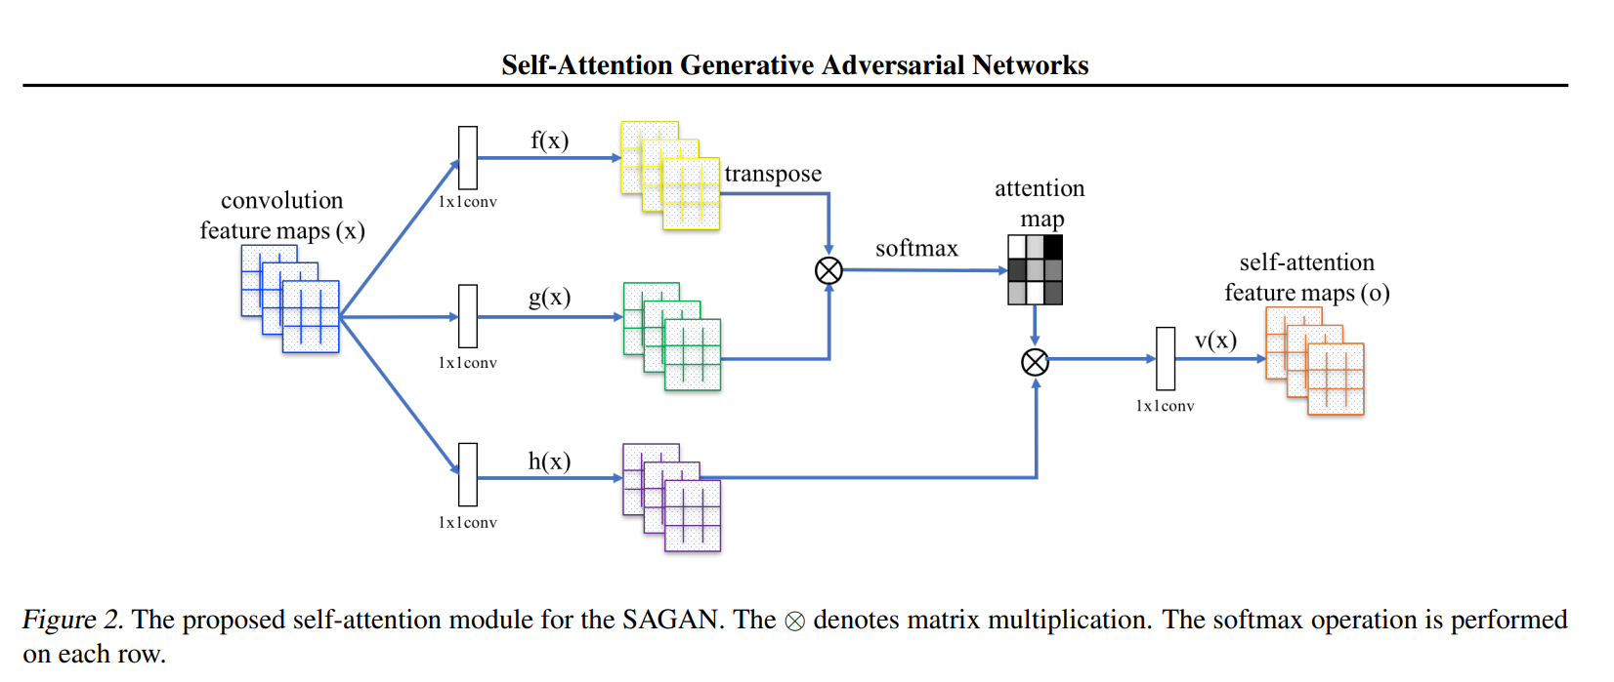
Introducing Attention | Upsampling & Discriminator
Convolutional layers process images locally, meaning they only consider a small neighborhood of pixels at a time. This can make it difficult for the network to capture long-range dependencies, which are important for tasks like image generation.
By incorporating a self-attention layer, the generator in a SAGAN can consider information from all parts of the image at once. The attention mechanism assigns weights to different parts of the image based on their importance for generating the current pixel. The discriminator can check that highly detailed features in distant portions of the image are consistent with each other.

Slide 21
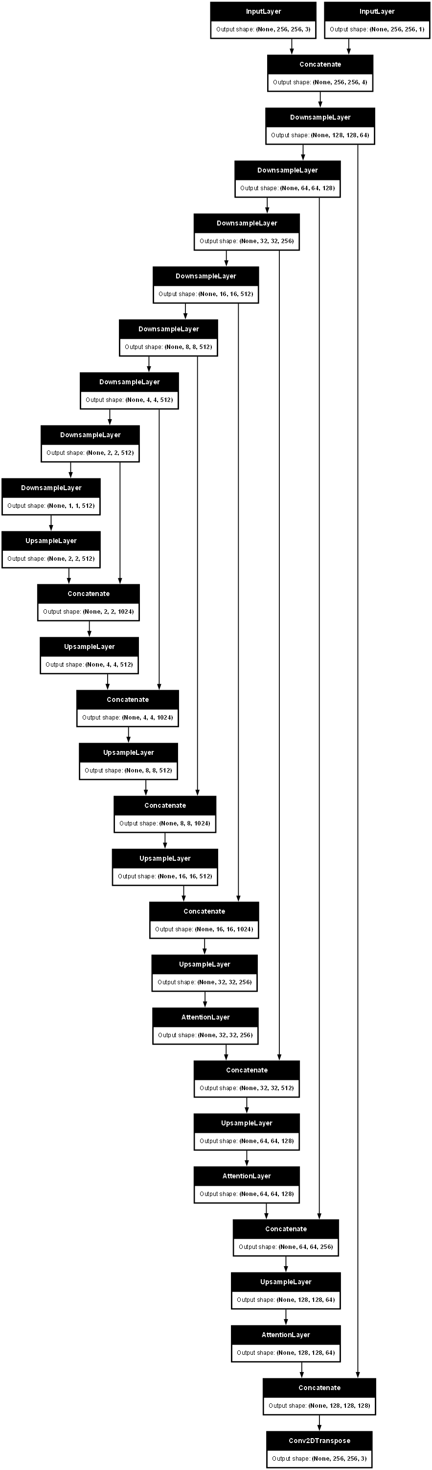
Introducing Attention
ATTENTION BLOCKS
COMPRESSED (1x1x512) REPRESENTATION OF IMAGE (AFTER DOWNSAMPLING)

Slide 22
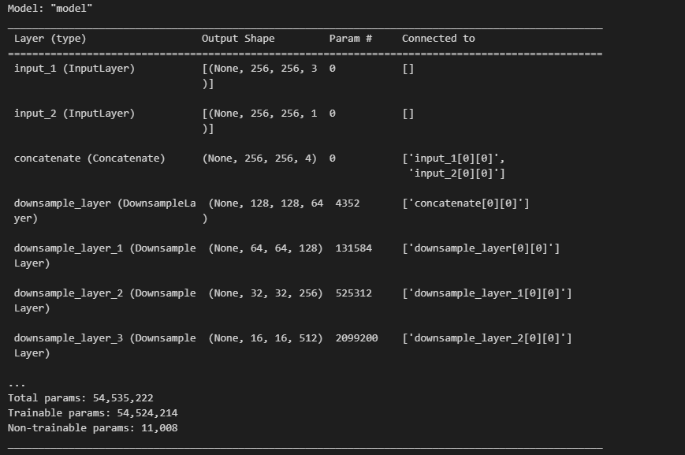
GAN Architecture | Attention + Edge
Same amount of parameters!

Slide 23
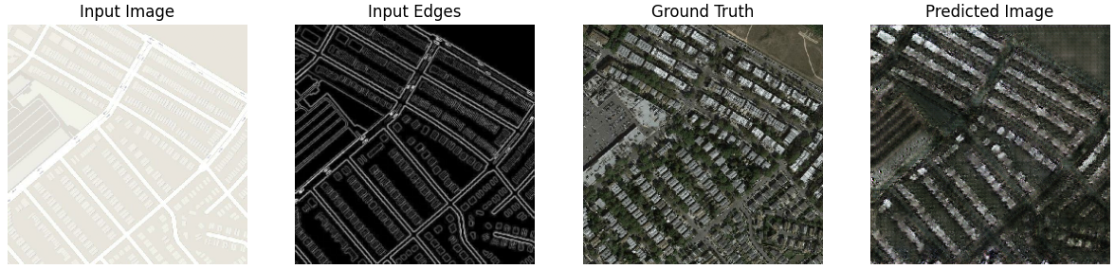
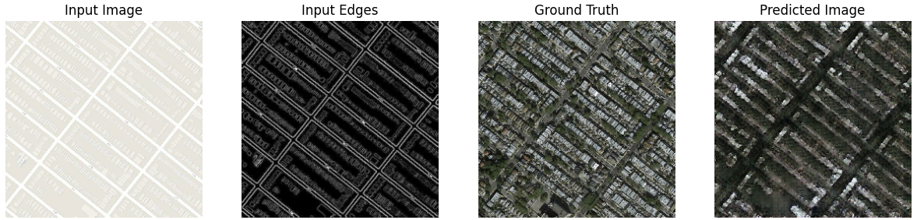
Training – After 40K Steps | Attention + Edge

Slide 24
Conclusions
Task (Overall, for Generator, for Discriminator).
Details of GAN implementation:
Architecture
Pix2Pix
Generator:
Tanh activation at the last layer
Loss function: weighted sum of L1 loss and gan_loss
Discriminator:
No activation function at the last layer
Loss function: sum of real_loss and generated_loss
Introduction of the Edge Map.
Introduction of Blur.
Introduction of the Attention Block.

Slide 25
Sources
Basic GAN architecture:
https://semiengineering.com/knowledge_centers/artificial-intelligence/neural-networks/generative-adversarial-network-gan/
ReLU/Leaky ReLU:
https://paperswithcode.com/method/rrelu
SAGAN paper:
https://arxiv.org/pdf/1805.08318.pdf
https://github.com/heykeetae/Self-Attention-GAN/blob/8714a54ba5027d680190791ba3a6bb08f9c9a129/sagan_models.py#L8

Slide 26
Thank you for your attention!

